Slide 2
Dynamic PGO in .NET 8
Andy Ayers
Egor Bogatov

Slide 3

.NET 8 is Fast
You probably know this already, but .NET 8 brings compelling performance improvements
over an already fast .NET 7, which brings compelling performance improvements
over an already fast .NET 6, which brings compelling performance improvements
over an already fast .NET 5….
How? Literally 1000’s of improvements all across the product, big and small.
See Performance Improvements in .NET 8 for a healthy sample
One of the “big” ones is Dynamic PGO

Slide 4
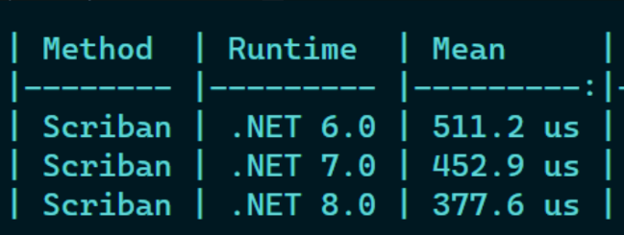
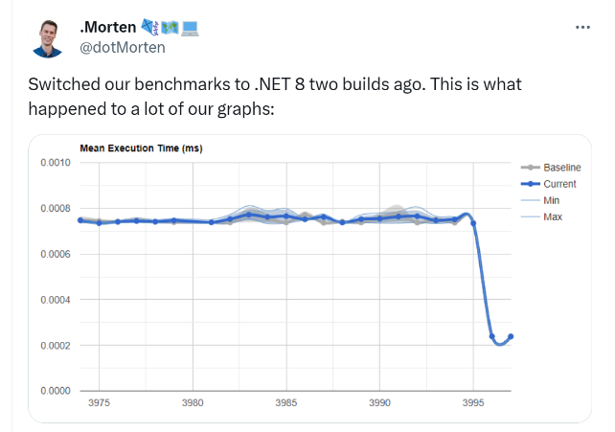
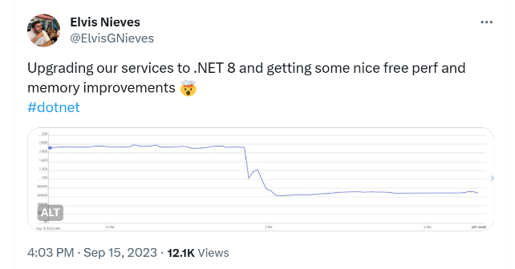
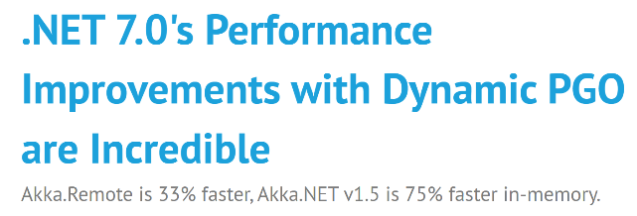
Dynamic PGO
Automatically boosts performance of most .NET apps
~15% is typical
No application changes needed; all you need to do is start using .NET 8

Slide 5

In This Talk
A behind-the-scenes look at Dynamic PGO
Optimizations
Instrumentation
Guidance if you’ve opted into PGO in earlier releases
Options to disable Dynamic PGO
Which you’ll hopefully never need
Things to watch out for when benchmarking

Slide 6
Background
PGO: Profile Guided Optimization
A compiler technique using profile data to guide code optimization
Dynamic PGO
Automatically gives the benefits of PGO
Works entirely in-process, no workflow or deployment changes needed, no training or special builds required
Leverages Tiered Compilation (introduced in .NET Core 3) to observe runtime behavior of methods by instrumenting codegen in initial tier(s) to build profiles
These profiles guide JIT optimization of code in later tiers
Widely used in Java (“HotSpot”) / JavaScript (“Trace JITs”)

Slide 7

Optimizations
Guarded Devirtualization (GDV)
Profile Guided Inlining
Code Layout

Slide 8
Guarded Devirtualization (GDV)
Many virtual and interface calls are “monomorphic” -- there is just one class observed at runtime
Even at “polymorphic” call sites there may be one predominant class
GDV will introduce tests for these specific types (the “guard”)
When the test succeeds, the JIT knows exactly which method will be called
AKA devirtualization
The JIT will also try and inline the method
If the method is on a value class, the JIT will inline the unboxing stub and the method
If the class is a boxed value type, the JIT will attempt to optimize away the box too
If the test fails, just do the normal virtual / interface call
.NET 8: GDV can handle some delegate invokes as well

Slide 9
GDV
void RegisterUser(IUserService service, User user)
{
service.Register(user); // virtual call
}

Slide 10
GDV
void RegisterUser(IUserService service, User user)
{
service.Register(user); // virtual call
}
void RegisterUser(IUserService service, User user)
{
CORINFO_HELP_CLASSPROFILE32(service.GetType());
service.Register(user);
}

Slide 11
GDV
void RegisterUser(IUserService service, User user)
{
service.Register(user); // virtual call
}
void RegisterUser(IUserService service, User user)
{
CORINFO_HELP_CLASSPROFILE32(service.GetType());
service.Register(user);
}
void RegisterUser(IUserService service, User user)
{
if (service is UserServiceImpl impl)
impl.Register(user); // direct call, can be inlined
else
service.Register(); // still virtual (fallback)
}

Slide 12
GDV Enabled Loop Cloning/Hoisting
If you have a virtual/interface/delegate call site in a loop, the guard checks within the loop may be loop invariant
The JIT can hoist the invariant guard checks outside the loop, and clone the loop so there are two copies, one with no guard checks
This combination can (partially) deabstract some common enumeration patterns (aka “zero-cost abstraction”)
There’s still room for improvement here…

Slide 13
GDV Cloning / Hoisting
private static int Sum(Func<int, int> func)
{
int sum = 0;
for (int i = 0; i < 10_000; i++)
{
sum += func(i); // delegate call
}
return sum;
}
private static int Sum(Func<int, int> func)
{
int sum = 0;
if (func.Method == KnownLambda)
{
for (int i = 0; i < 10_000; i++)
{
sum += i + 1;
}
}
else
{
for (int i = 0; i < 10_000; i++)
{
sum += func(i);
}
}
return sum;
}
Tier0+Instr
Tracks the method invoked at the delegate call site
Tier1
Sees that just one method is invoked at the call site, and adds a GDV check
Inlines the call on the path where the check succeeds
Sees that the GDV check is a loop invariant, and clones the loop to create a check-free version

Slide 14

Profile-Guided Inlining
Use profile data to ensure key methods are inlined
Relaxed thresholds for IL size and number of basic blocks
Spend less JIT time on (semi-) cold call sites

Slide 15
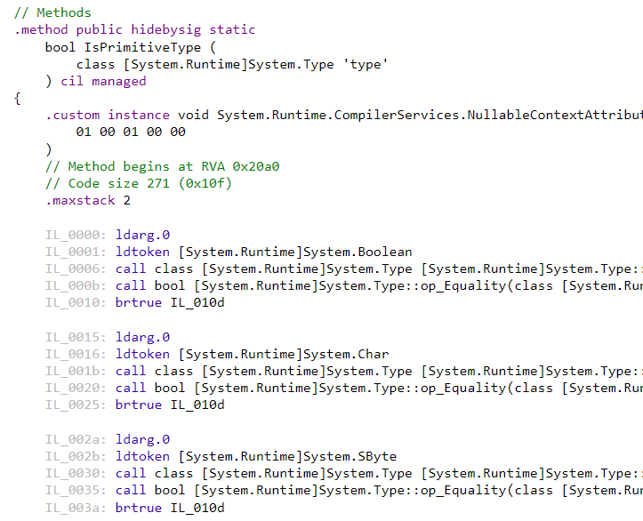
Profile-Guided Inlining
bool IsPrimitiveType(Type type) =>
type == typeof(bool) ||
type == typeof(char) ||
type == typeof(sbyte) ||
type == typeof(byte) ||
type == typeof(short) ||
type == typeof(ushort) ||
type == typeof(int) ||
type == typeof(uint) ||
type == typeof(long) ||
type == typeof(ulong) ||
type == typeof(float) ||
type == typeof(double) ||
type == typeof(nint) ||
type == typeof(nuint);

Slide 16
Profile-Guided Inlining
for (int i = 0; i < 100; i++)
{
Test<int, float>();
Thread.Sleep(16);
}
[MethodImpl(MethodImplOptions.NoInlining)]
static bool Test<T1, T2>() =>
IsPrimitiveType(typeof(T1)) &&
IsPrimitiveType(typeof(T2));
static bool IsPrimitiveType(Type type) =>
type == typeof(bool) ||
type == typeof(char) ||
type == typeof(sbyte) ||
type == typeof(byte) ||
type == typeof(short) ||
type == typeof(ushort) ||
type == typeof(int) ||
type == typeof(uint) ||
type == typeof(long) ||
type == typeof(ulong) ||
type == typeof(float) ||
type == typeof(double) ||
type == typeof(nint) ||
type == typeof(nuint);
; Assembly listing for method Program:Test[int,float]():bool ; Tier-1 compilation ; No PGO data sub rsp, 40 mov rcx, 0x11B802000B8 ; 'System.Int32' call [Program:IsPrimitiveType(System.Type):bool] test eax, eax je SHORT G_M27198_IG05 mov rcx, 0x11B80205090 ; 'System.Single' call [Program:IsPrimitiveType(System.Type):bool] nop add rsp, 40 ret G_M27198_IG05: xor eax, eax add rsp, 40 ret ; Total bytes of code 53
Inliner: too many IL bytes

Slide 17
Profile-Guided Inlining
for (int i = 0; i < 100; i++)
{
Test<int, float>();
Thread.Sleep(16);
}
[MethodImpl(MethodImplOptions.NoInlining)]
static bool Test<T1, T2>() =>
IsPrimitiveType(typeof(T1)) &&
IsPrimitiveType(typeof(T2));
static bool IsPrimitiveType(Type type) =>
type == typeof(bool) ||
type == typeof(char) ||
type == typeof(sbyte) ||
type == typeof(byte) ||
type == typeof(short) ||
type == typeof(ushort) ||
type == typeof(int) ||
type == typeof(uint) ||
type == typeof(long) ||
type == typeof(ulong) ||
type == typeof(float) ||
type == typeof(double) ||
type == typeof(nint) ||
type == typeof(nuint);
; Assembly listing for method Program:Test[int,float]():bool ; Tier-1 compilation ; Optimized with Dynamic PGO mov eax, 1 ret ; Total bytes of code 6
Inliner:
Inline candidate has 13 foldable branches.
Inline has 28 foldable intrinsics.
Callsite has profile data: 1.0.

Slide 18
Profile Guided Code Layout
; Tests.Sum(System.Func`2<Int32,Int32>)
push rdi
push rsi
push rbx
sub rsp,20
mov rbx,rcx
xor esi,esi
xor edi,edi
test rbx,rbx
je short M01_L01
mov rax,7FFA2D630F78
cmp [rbx+18],rax
jne short M01_L01
M01_L00:
inc edi
mov eax,edi
add esi,eax
cmp edi,2710
jl short M01_L00
jmp short M01_L03
M01_L01:
mov rax,7FFA2D630F78
cmp [rbx+18],rax
jne short M01_L04
lea eax,[rdi+1]
M01_L02:
add esi,eax
inc edi
cmp edi,2710
jl short M01_L01
M01_L03:
mov eax,esi
add rsp,20
pop rbx
pop rsi
pop rdi
ret
M01_L04:
mov edx,edi
mov rcx,[rbx+8]
call qword ptr [rbx+18]
jmp short M01_L02
PGO will compact the “hot code” in a method towards the start of the method.
private static int Sum(Func<int, int> func)
{
int sum = 0;
if (func.Method == KnownLambda)
{
for (int i = 0; i < 10_000; i++)
{
sum += i + 1;
}
}
else
{
for (int i = 0; i < 10_000; i++)
{
sum += func(i);
}
}
return sum;
}

Slide 19

Instrumentation
How PGO gathers the data needed for optimization

Slide 20
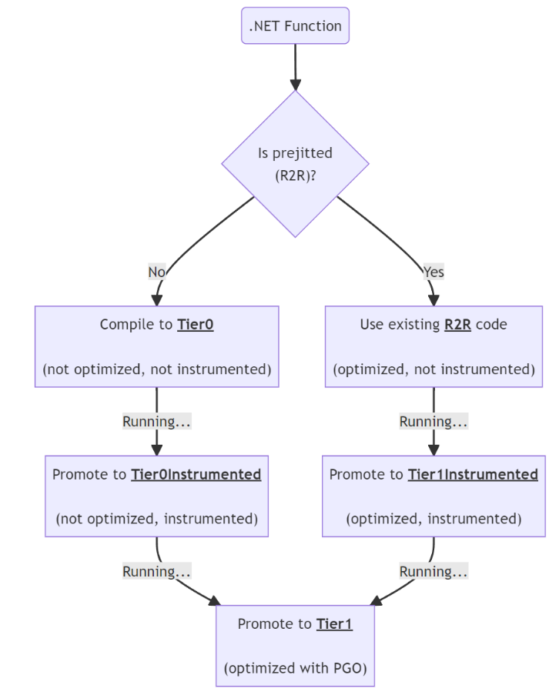
Instrumentation Tiers
Code versions:
R2R'd code
Tier0
Tier0 with instrumentation
Tier1 with instrumentation
Tier1 optimized with (or without) previously collected profile
Not shown here:
OSR
Tier0 with loops

Slide 21
Instrumentation Overhead
In .NET 8 we did a lot of work to reduce overhead from instrumentation
Dynamic PGO startup improvements in NET 8 · Issue #76969
Sparse edge profiles enabled for all methods
GDV random state now in TLS (thread-local storage)
Scalable profile counters
JIT: scalable profile counter mode #84427
More cases where the JIT will bypass instrumentation
Enable intrinsic expansion in Tier0

Slide 22
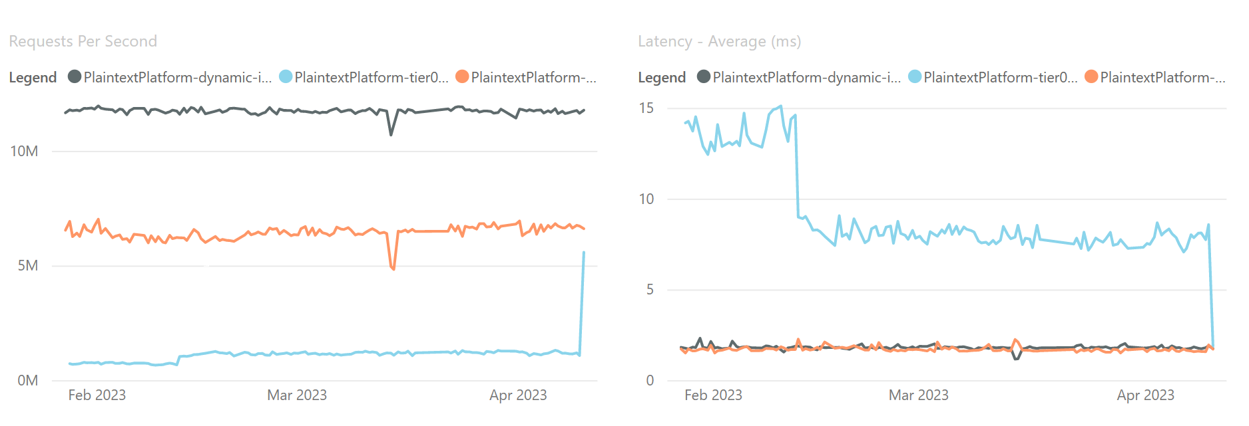
Impact of improvements to instrumentation on Tech Empower RPS / Latency
Tier1
Tier0
Tier0 + Instr

Slide 23

Configuration
How to enable, disable, or update configuration settings

Slide 24

To enable Dynamic PGO
Update to .NET 8
Dynamic PGO is enabled by default in .NET 8. Nothing else is required.
Review configuration settings to make sure you’re not disabling any of these runtime features:
TieredCompilation
ReadyToRun
QuickJitForLoops
OnStackReplacement

Slide 25

If you’ve opted into PGO in .NET 6 or 7
Thank you for being an early adopter!
With the new tiering strategy, PGO and ReadyToRun play nicely together
You can remove the following config settings
DOTNET_ReadyToRun=0
DOTNET_QuickJitForLoops=1
DOTNET_TieredPGO=1

Slide 26
To Disable PGO
Set DOTNET_TieredPGO=0
Or <TieredPGO>false</TieredPGO> in the project file
This will restore .NET 7’s behavior
If you disable PGO, please loop us in, so we can learn how to make it better

Slide 27

Performance, Profiling & Benchmarking

Slide 28
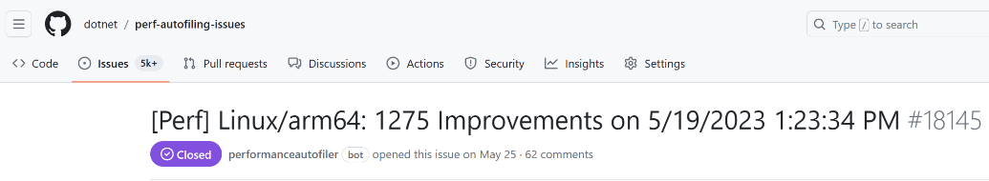
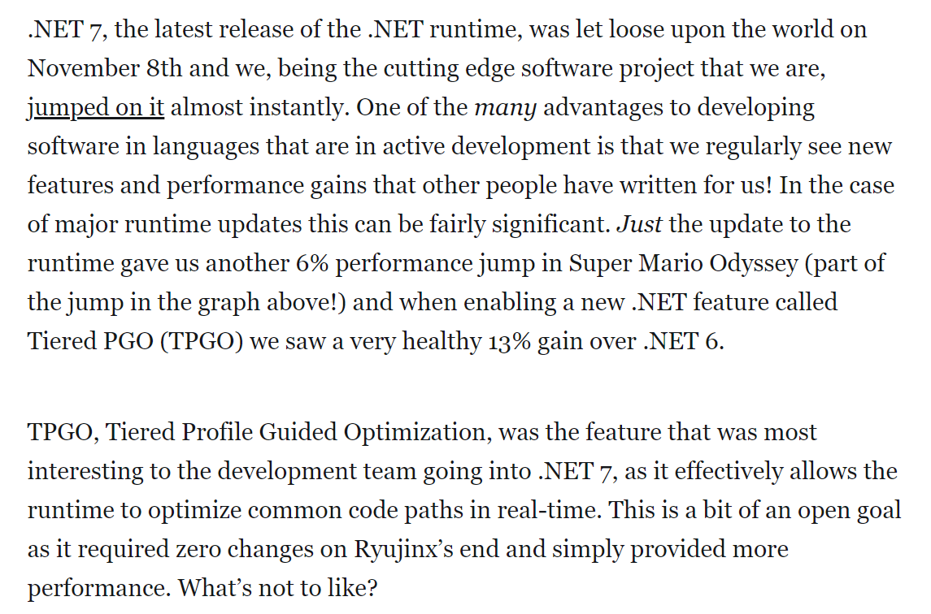
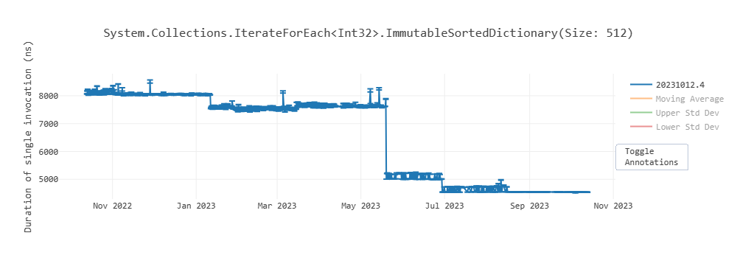
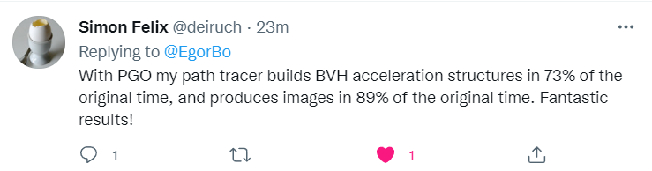
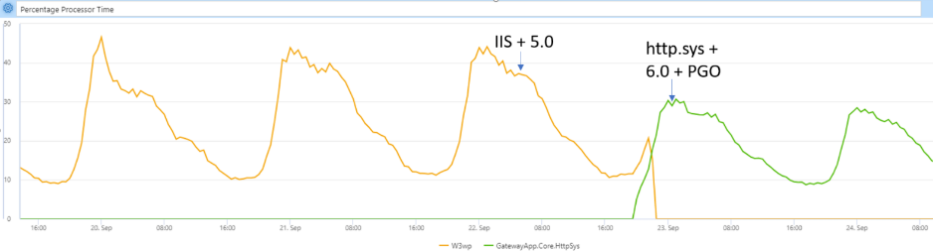
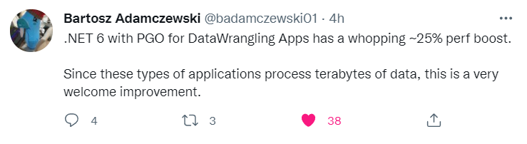






Our own benchmarks
Ryujinx
More
AAD Gateway

Slide 29
With PGO enabled
You should see an improvement in steady-state perf
Very short running, JIT intensive apps may not speed up
Note even without PGO, .NET 8 can deliver impressive speedups
You may see some impact to startup
Either longer start up times, or for a server, increased latency at startup
You may see more methods jitted overall
Some methods will be jitted multiple times:
Tier0, Tier0+Instrumentation, OSR, Tier1
There may be PGO specific bugs, either correctness or performance
If you suspect a bug, try running with PGO disabled, via DOTNET_TieredPGO=0 or via the config settings
If PGO makes things slower, contact us or file an issue

Slide 30
PGO & Benchmarks
BenchmarkDotNet (BDN) usually does a good job of ensuring you are measuring the optimized tiers
But if your benchmark method takes > 100ms or more, it may not
If you are doing ad-hoc benchmarking (say via Stopwatch) you also may not see representative data
PGO may bypass certain tricks you may have used to isolate performance (eg via delegates)
BDN itself is hardened to this.
Benchmark cases may now show unrealistic performance results when the input set is limited. PGO can infer things about those inputs (say running with just one class of data, or one string length)
We need to keep an eye on this one… (more on next slide)

Slide 31
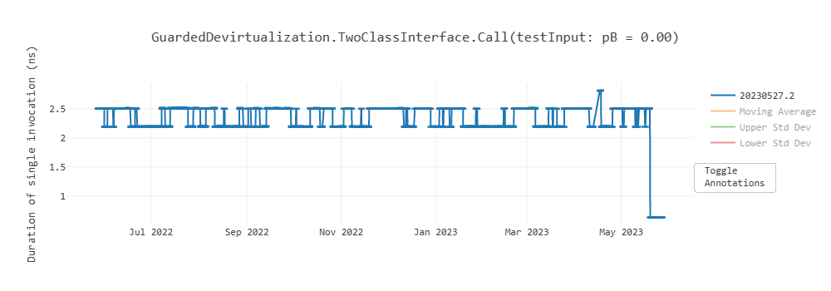
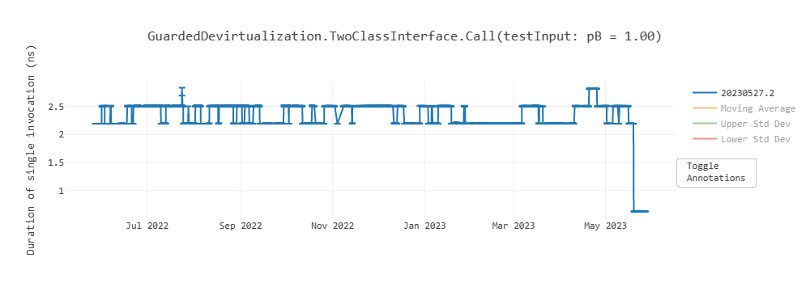
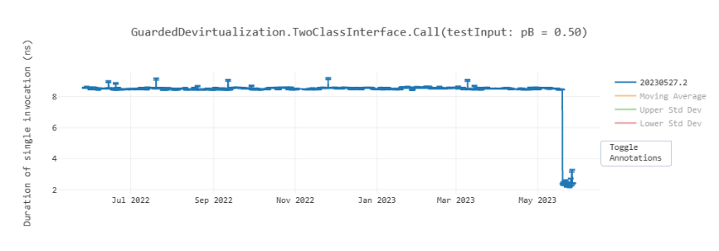
… PGO & Benchmarks
A
Time(Input Set A) = X
Time(Input Set B) = Y
Time(50/50 Mix of A & B) = ??
Measuring specific case performance may not help you understand more general performance.
Time(50/50 Mix of A & B) will likely be greater than X or Y
From the example at left (Interface call overhead)
Time(A): 2.5ns (with PGO: ~0ns)
Time(B): 2.5ns (with PGO: ~0ns)
Time(A & B mixed): 8.0ns (with PGO: ~2ns)
With PGO this sort of thing may happen more often, in a wider variety of situations, and with greater disparity.
Advice: try and measure representative scenarios
B
½ A + ½ B

Slide 32

To Recap
Dynamic PGO is enabled by default in .NET 8
It offers a broad range of performance improvements
All you need to do is update!
Let us know your experiences, good or bad!

Slide 33

Resources
Download .NET 8 aka.ms/get-dotnet-8
.NET 8 Runtime Repo (details, issues, feedback) https://github.com/dotnet/runtime

Slide 34
Download .NET 8
https://aka.ms/get-dotnet-8

